Slide 1
MSc Thesis Defense
Relation and Knowledge Aware Zero Shot Learning in 3D Object Recognition
Md Fokhrul Islam
Exam Roll: 120702
Reg. No.: 2016-914-692
Course Code: RME 5401
Supervisor:
Dr. Sejuti Rahman
Associate Professor
Dept. of RME, DU
Dept. of Robotics & Mechatronics Engineering
University of Dhaka

Slide 2
Agenda
Introduction
Motivation
Problem Definition
Related Work
Novelty
Limitation of Existing Literature
Ours’ Novelty
Proposed Approach
Text-Image Alignment
Knowledge Graph Construction
Common Sense Embedding Learning
Contrastive GAN framework
Instance-level Contrastive Embedding
Experiments & Results
Dataset
Overall Result (benchmark, backbone and prompt analysis)
Ablation (t-SNE plot, component and confusion matrix analysis)
Conclusion

Slide 3
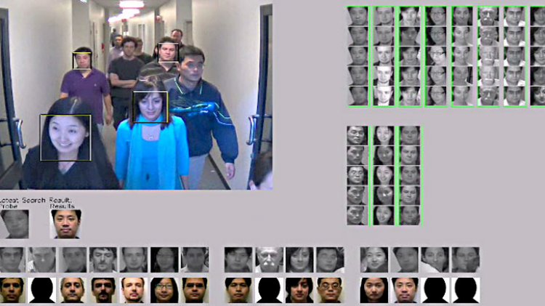
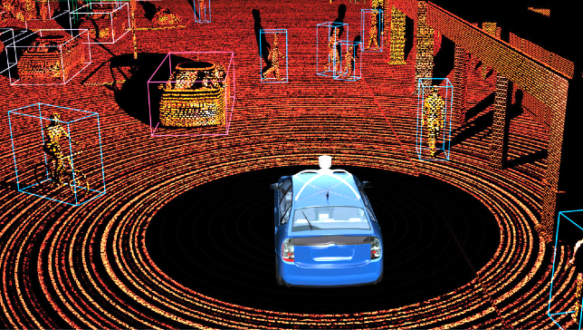
Motivation: 2D vs 3D
2D vision:
Limitations: Lack of depth, viewpoint dependency
harder for 2D vision to perform high level real-world tasks
3D vision:
Advantages: Depth perception, robustness to pose variations
Object recognition in robotics, augmented reality and autonomous vehicles
Facial recognition
Robot perception

Slide 4

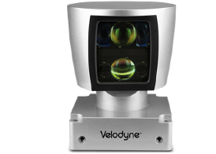
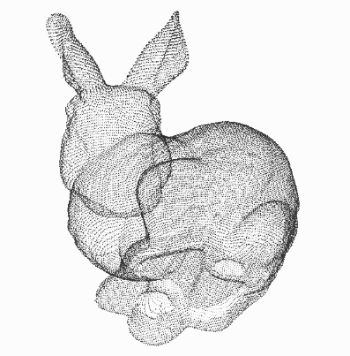
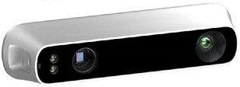
3D Representation and Learning
Point cloud is close to raw sensor data
End-to-end learning for scattered, unordered point data
Unified framework for various tasks
LiDAR
(1) Classification
(2) Segmentation
…
PointNet^{[1]}
Depth Sensor
Point Cloud
[1] C. R. Qi, H. Su, K. Mo, and L. J. Guibas, “Pointnet: Deep learning on point sets for 3d classification and segmentation,” in Proceedings of the IEEE conference on computer vision and pattern recognition, 2017, pp. 652–660

Slide 5
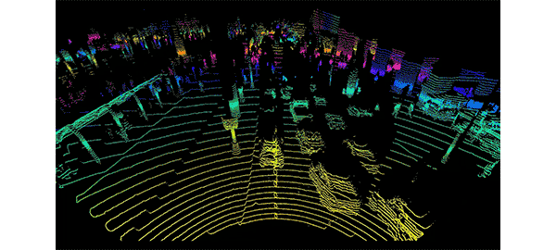
Motivation: What Machine See in Real World?
Two type of scenario may occur in this situation:
(a) Already known through supervision by trained on large amount of data
(b) Never seen this type of objects
Already known
Appear first time
Courtesy: New York Times, What Self-Driving Cars See?

Slide 6
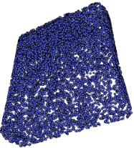
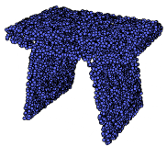
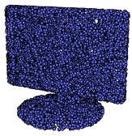
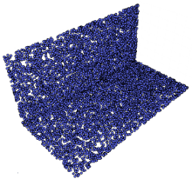
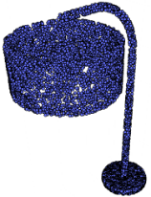
Problem Definition
S (Seen classes)
U (Unseen classes)
Train on classes in S.
For ZSL: Test on
classes in U
(b) For GZSL: Test on
classes in S and U
Need electricity
yes
table
metal
no
floor
wood
yes
table
metal
yes
table
metal
yes
table
metal
Placed on
Made of
Generally, the learning is achieved using additional side-information called semantic
embedding or attributes vectors.
(2) These semantic embedding encode the intra class relationships between all the
seen (S) and unseen (U) classes
*Example images come from ModelNet40 dataset

Slide 7
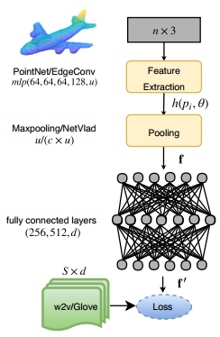
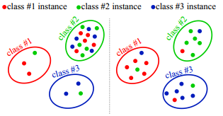
Related Work
Zero-shot Learning of 3D Point Cloud Objects^{[2]}
First paper to introduced ZSL problem in 3D point cloud classification
Their architecture used semantic word vectors
Mitigating the Hubness Problem for Zero-Shot Learning of 3D Objects^{[3]}
New loss proposed to mitigate the hubness problem of 3D-ZSL task(s)
More ZSL and GZSL benchmark result provided for 3D point cloud classification
[2] A. Cheraghian, S. Rahman, and L. Petersson, “Zero-shot learning of 3d point cloud objects,” in 2019 16th International Conference on Machine Vision Applications (MVA). IEEE, 2019, pp. 1–6. [3] A. Cheraghian, S. Rahman, D. Campbell, and L. Petersson, “Mitigating the hubness problem for zero-shot learning of 3d objects,” arXiv preprint arXiv:1907.06371, 2019

Slide 8
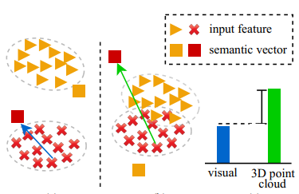
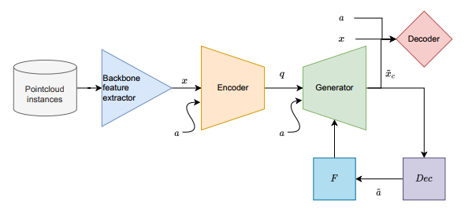
Related Work (2)
Transductive Zero-Shot Learning for 3D Point Cloud Classification^{[4]}
Reduced the bias and encouraged the projected semantic vectors to align with their true feature vector
Developed a novel triplet loss to minimize the average intra-class distance
Improving 3D object Recognition with Con-textual Information and Meta Learning ^{[5]}
First method to apply GAN based approach on 3D ZSL
Used 2D image features as auxiliary info
[4] A. Cheraghian, S. Rahman, D. Campbell, and L. Petersson, “Transductive zero-shot learning for 3d point cloud classification,” in Proceedings of the IEEE/CVF Winter Conference on Applications of Computer Vision, 2020, pp. 923–933. [5] Muhammad Tahmeed Abdullah. "Improving 3D object Recognition with Contextual Information and Meta Learning." Master's thesis in department of Robotics and Mechatronics Engineering, University of Dhaka (2022).

Slide 9
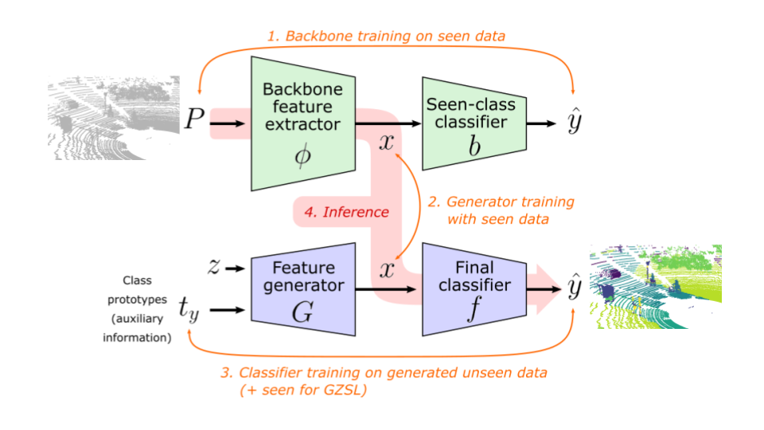
Related Work (3)
Generative Zero-Shot Learning for Semantic Segmentation of 3D Point Clouds^{[6]}
Proposed a generative framework and provide 3 benchmarks.
Provided evidence that generation based method can perform better in GZSL
Failed to incorporate Image-text embedding and left it for future researcher
[6] Michele, Björn, et al. "Generative zero-shot learning for semantic segmentation of 3d point clouds." 2021 International Conference on 3D Vision (3DV). IEEE, 2021.

Slide 10
Limitations in Existing Literatures
Limitations in existing works:
Cannot connect different class in semantic space [No relation]
Using only 2D (one/some) image can not be viable because of image variations [need to learn class attribute]
Generative unseen features are more bias toward seen class [no distinct feature representation]

Slide 11
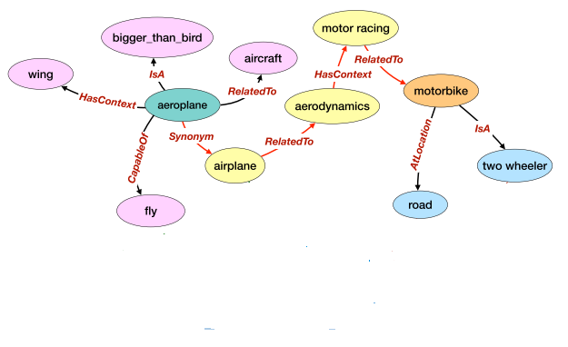
Novelty
Knowledge aware:
Connect all concepts through knowledge graph.
They relate each other through learned embedding
Relational aware:
Extend the implicit information by incorporating 2D image feature with text
Both modalities make relation based on leaned feature

Slide 12
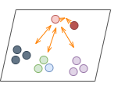
Novelty(2)
More distinct synthetic feature leaning:
Learn a more accurate 3D visual feature representation using contrastive semi supervised leaning
This will also solve bias problem occur in seen-unseen classes

Slide 13

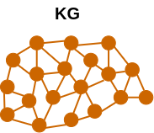

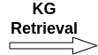
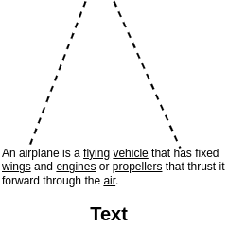
Knowledge Graph Construction

Slide 14
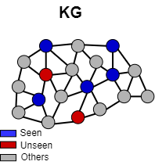
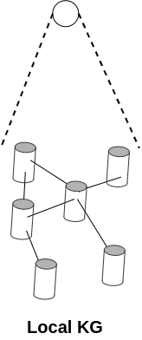

Knowledge Graph Construction

Slide 15
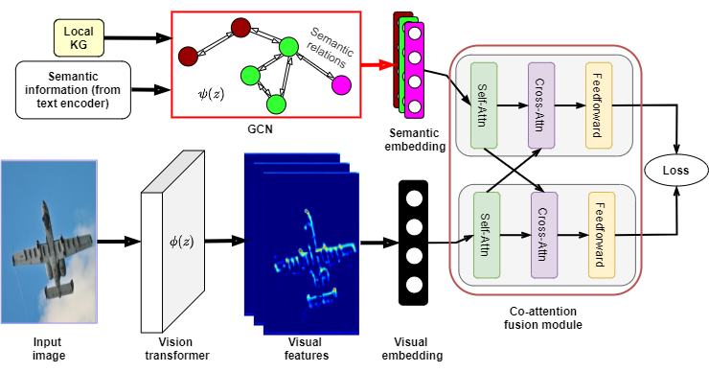
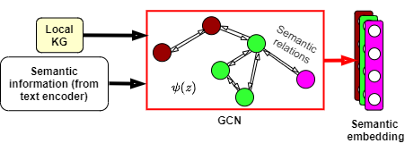
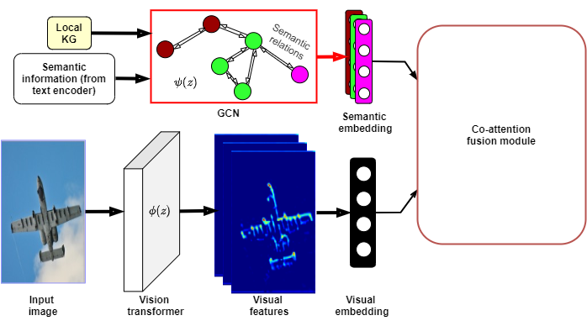
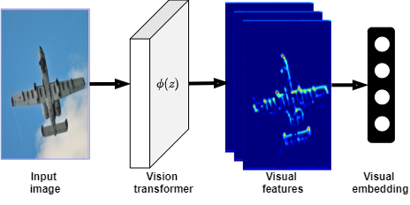
Common Sense Embedding Learning

Slide 16
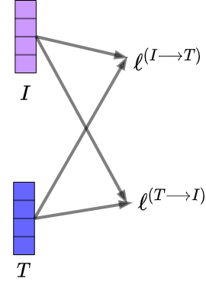
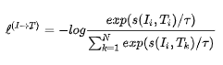
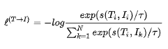
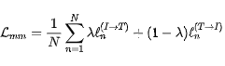
Text-Image Alignment Loss

Slide 17
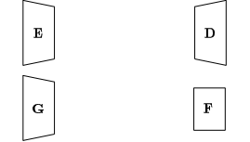
Contrastive GAN Framework
E: Point cloud encoder
G: Generator network
D: Discriminator network
F: Classifier network

Slide 18
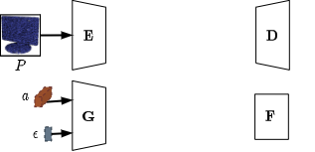
Contrastive GAN Framework
Provide input 3D point cloud to encoder
Generator net. take both attribute of class and random noise
E: Point cloud encoder
G: Generator network
D: Discriminator network
F: Classifier network
P: Point cloud sample
a: Attribute vector
ꜫ: noise

Slide 19
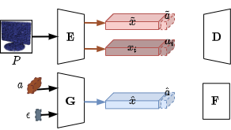
Contrastive GAN Framework(2)
Provide input 3D point cloud to encoder
Generator net take both attribute of class and random noise
Encoder convert each P into respective embedding
Generator create embedding based on given input
E: Point cloud encoder
G: Generator network
D: Discriminator network
F: Classifier network
P: Point cloud sample
a: Attribute vector
ꜫ: noise
x: point cloud embedding

Slide 20
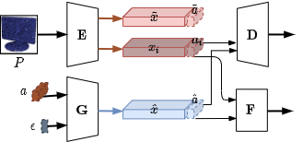
Contrastive GAN Framework(3)
Provide input 3D point cloud to encoder
Generator net take both attribute of class and random noise
Encoder convert each P into respective embedding
Generator create embedding based on given input
Discriminator classify the given input is real or fake
E: Point cloud encoder
G: Generator network
D: Discriminator network
F: Classifier network
P: Point cloud sample
a: Attribute vector
ꜫ: noise
x: point cloud embedding

Slide 21
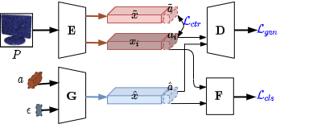
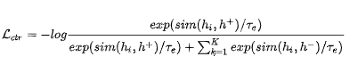
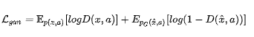
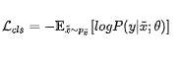
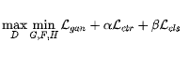
Contrastive GAN Framework(4)
Then calculate three loss function and optimize through backprop algorithm
E: Point cloud encoder
G: Generator network
D: Discriminator network
F: Classifier network
P: Point cloud sample
a: Attribute vector
ꜫ: noise
x: point cloud embedding
Optimize:

Slide 22
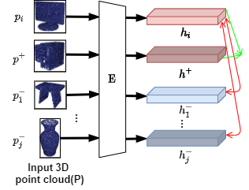
Instance-level Contrastive Embedding
Make similar class instance closer to one another
Repulsing dissimilar classes sample
Learn it though contrastive loss

Slide 23
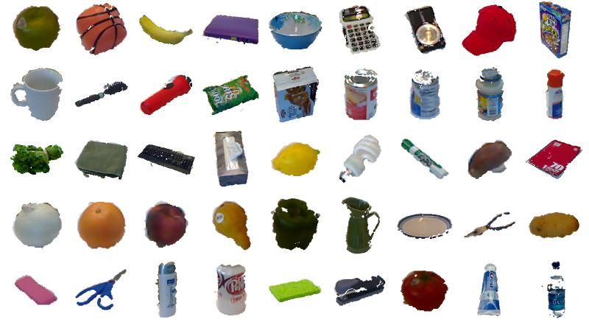
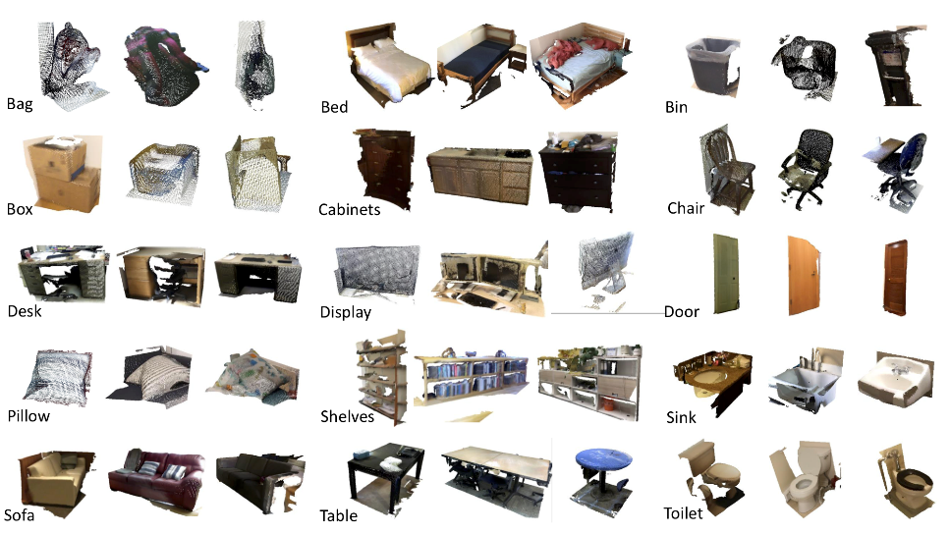
Datasets: Real-world
1. RGB-D^{[7]}
2. ScanObjectNN^{[8]}
Total class: 51
Seen/ Unseen: 41/10
Train/Valid/Test: 8032/2135/1607
Newly benchmarked real world dataset
Total class: 37
Seen/ Unseen: 26/11
Train/Valid/Test: 2902/819/495
Real world dataset
[7] K. Lai, L. Bo, X. Ren, and D. Fox, “A large-scale hierarchical multi-view rgb-d object dataset,” in 2011 IEEE international conference on robotics and automation. IEEE, 2011, pp. 1817–1824. [8] M. A. Uy, Q.-H. Pham, B.-S. Hua, T. Nguyen, and S.-K. Yeung, “Revisiting point cloud classification: A new benchmark dataset and classification model on real-world data,” in Proceedings of the IEEE/CVF ICCV, 2019.

Slide 24
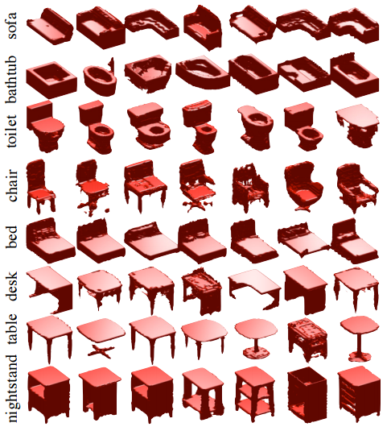
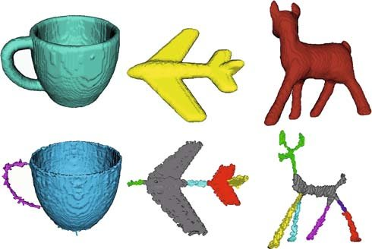
Datasets: Synthetic
3. ModelNet40^{[9]}
4. McGill^{[10]}
Total class: 40
Seen/ Unseen: 30/10
Train/Valid/Test: 5852/1560/908
Widely used and synthetic dataset
Total class: 44
Seen/ Unseen: 30/14
Train/Valid/Test: 5852/1560/115
Synthetic dataset
[9] Z. Wu, S. Song, A. Khosla, F. Yu, L. Zhang, X. Tang, and J. Xiao, “3d shapenets: A deep representation for volumetric shapes,” in Proceedings of the IEEE CVPR, 2015. [10] K. Siddiqi, J. Zhang, D. Macrini, A. Shokoufandeh, S. Bouix, and S. Dickinson, “Retrieving articulated 3-d models using medial surfaces,” Machine vision and applications, vol. 19, pp. 261–275, 2008.

Slide 25
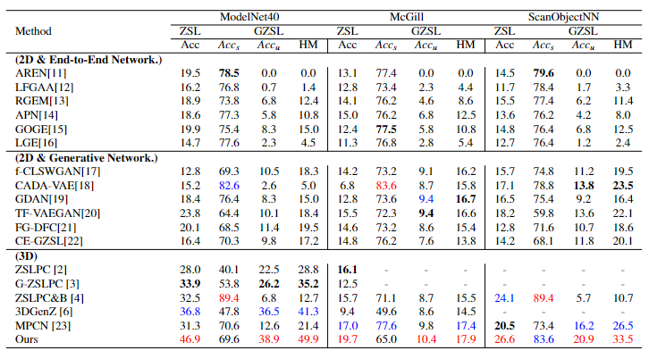
Overall Results
Table 1: Overall result
[2] A. Cheraghian, S. Rahman, and L. Petersson, “Zero-shot learning of 3d point cloud objects,” in 2019 16th International Conference on Machine Vision Applications (MVA). IEEE, 2019, pp. 1–6. [3] A. Cheraghian, S. Rahman, D. Campbell, and L. Petersson, “Mitigating the hubness problem for zero-shot learning of 3d objects,” in British Machine Vision Conference (BMVC’19), 2019 [4] A. Cheraghian, S. Rahman, D. Campbell, and L. Petersson, “Transductive zero-shot learning for 3d point cloud classification,” in Proceedings of the IEEE/CVF Winter Conference on Applications of Computer Vision, 2020, pp. 923–933 [6] Michele, Björn, et al. "Generative zero-shot learning for semantic segmentation of 3d point clouds." 2021 International Conference on 3D Vision (3DV). IEEE, 2021.

Slide 26
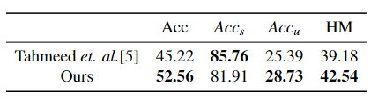
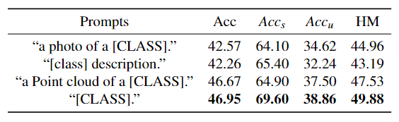
Overall Results (2)
Table 2: Overall result on RGB-D dataset
Table 3: Result on different text prompt
[5] Muhammad Tahmeed Abdullah. "Improving 3D object Recognition with Contextual Information and Meta Learning." Master's thesis in department of Robotics and Mechatronics Engineering, University of Dhaka (2022).

Slide 27
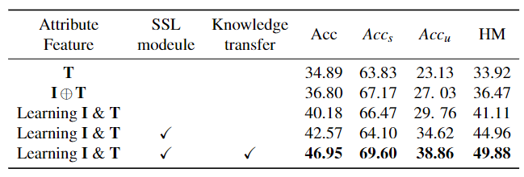
Ablation Studies: Component Analysis
Concatenate of image and text embedding
Only text embedding
Final model
Table 4: Comparing result with different components of model. Here ⊕, I and T represents concatenate, image embedding and text embedding respectively.
Learning embedding from both modalities
Incorporating point-wise contrastive learning in intermediate feature map

Slide 28
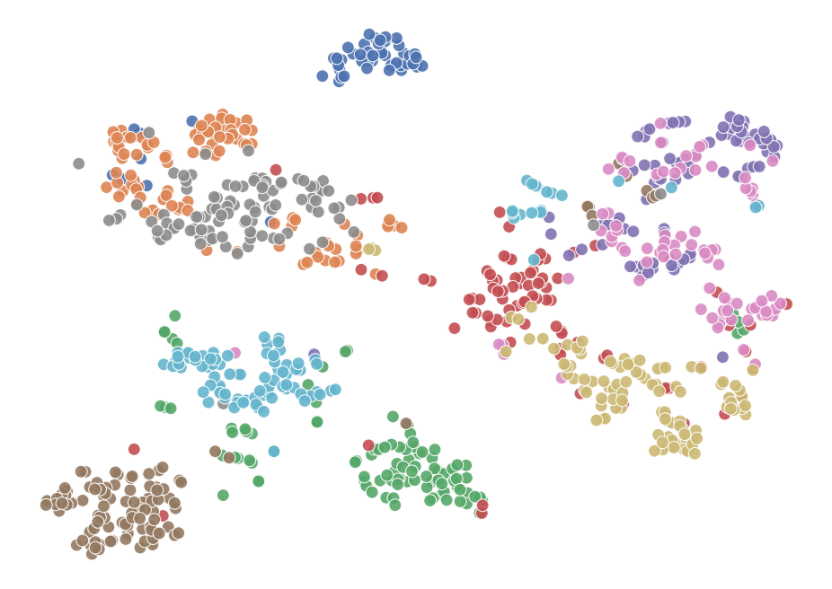


Ablation Studies: t-SNE Analysis
Observations:
Several unseen classes share
common embedding space(they
closer to each other).
2. Some class has distinct 3D visual
Embedding(which is expected).
(a) Baseline
Solutions:
Providing an inter and intra-class self-
supervised contrastive loss can further
Improve the embedding
2. Which make instances of similar class closer
to each other and repulse the instances of other
classes
(b) Ours

Slide 29





Results Analysis: ZSL Confusion Matrix
(a) 3DGenZ^{[6]}
(b) Ours
Figure : ZSL confusion matrix
[6] B. Michele, A. Boulch, G. Puy, M. Bucher, and R. Marlet, “Generative zero-shot learning for semantic segmentation of 3d point clouds,” in 2021 International Conference on 3D Vision (3DV). IEEE, 2021, pp. 992–1002.

Slide 30


Results Analysis: GZSL Confusion Matrix
(a) Baseline
(b) Ours
Figure : GZSL confusion matrix

Slide 31
Conclusion
We use the commonsense knowledge graph with GCN to produce commonsense embedding
We propose co-attention based multi-model learning to distil info from both semantic and 2D visual data
Also design an contrastive based generative framework to distil unseen augmented features
Experimental findings showed that our method outperformed existing approach on a 3D visual dataset
Further research should be done on other task like segmentation, detection in Zero shot setup

Slide 32
Reference
[1] C. R. Qi, H. Su, K. Mo, and L. J. Guibas, “Pointnet: Deep learning on point sets for 3d classification and segmentation,” in Proceedings of the IEEE conference on computer vision and pattern recognition, 2017, pp. 652–660
[2] A. Cheraghian, S. Rahman, and L. Petersson, “Zero-shot learning of 3d point cloud objects,” in 2019 16th International Conference on Machine Vision Applications (MVA). IEEE, 2019, pp. 1–6.
[3] A. Cheraghian, S. Rahman, D. Campbell, and L. Petersson, “Mitigating the hubness problem for zero-shot learning of 3d objects,” arXiv preprint arXiv:1907.06371, 2019
[4] A. Cheraghian, S. Rahman, D. Campbell, and L. Petersson, “Transductive zero-shot learning for 3d point cloud classification,” in Proceedings of the IEEE/CVF Winter Conference on Applications of Computer Vision, 2020, pp. 923–933.
[5] Muhammad Tahmeed Abdullah. "Improving 3D object Recognition with Contextual Information and Meta Learning." Master's thesis in department of Robotics and Mechatronics Engineering, University of Dhaka (2022).
[6] Michele, Björn, et al. "Generative zero-shot learning for semantic segmentation of 3d point clouds." 2021 International Conference on 3D Vision (3DV). IEEE, 2021.
[7] K. Lai, L. Bo, X. Ren, and D. Fox, “A large-scale hierarchical multi-view rgb-d object dataset,” in 2011 IEEE international conference on robotics and automation. IEEE, 2011, pp. 1817–1824.
[8] M. A. Uy, Q.-H. Pham, B.-S. Hua, T. Nguyen, and S.-K. Yeung, “Revisiting point cloud classification: A new benchmark dataset and classification model on real-world data,” in Proceedings of the IEEE/CVF ICCV, 2019.
[9] Z. Wu, S. Song, A. Khosla, F. Yu, L. Zhang, X. Tang, and J. Xiao, “3d shapenets: A deep representation for volumetric shapes,” in Proceedings of the IEEE CVPR, 2015.
[10] K. Siddiqi, J. Zhang, D. Macrini, A. Shokoufandeh, S. Bouix, and S. Dickinson, “Retrieving articulated 3-d models using medial surfaces,” Machine vision and applications, vol. 19, pp. 261–275, 2008.

Slide 33
Reference(2)
[11] G.-S. Xie, L. Liu, X. Jin, F. Zhu, Z. Zhang, J. Qin, Y. Yao, and L. Shao, “Attentive region embedding network for zero-shot learning,” in Proceedings of the IEEE/CVF conference on computer vision and pattern recognition, 2019, pp.
9384–9393
[12] Y. Liu, J. Guo, D. Cai, and X. He, “Attribute attention for semantic disambiguation in zero-shot learning,” in Proceedings of the IEEE/CVF international conference on computer vision, 2019, pp. 6698–6707.
[13] G.-S. Xie, L. Liu, F. Zhu, F. Zhao, Z. Zhang, Y. Yao, J. Qin, and L. Shao, “Region graph embedding network for zero-shot learning,” in Computer Vision–ECCV 2020: 16th European Conference, Glasgow, UK, August 23–28, 2020, Proceedings, Part IV 16. Springer, 2020, pp. 562–580.
[14] W. Xu, Y. Xian, J. Wang, B. Schiele, and Z. Akata, “Attribute prototype network for zero-shot learning,” Advances in Neural Information Processing Systems, vol. 33, pp. 21 969–21 980, 2020.
[15] Y. Liu, L. Zhou, X. Bai, Y. Huang, L. Gu, J. Zhou, and T. Harada, “Goal-oriented gaze estimation for zero-shot learning,” in Proceedings of the IEEE/CVF conference on computer vision and pattern recognition, 2021, pp. 3794–3803.
[16] M. F. Naeem, Y. Xian, F. Tombari, and Z. Akata, “Learning graph embeddings for compositional zero-shot learning,” in Proceedings of the IEEE/CVF Conference on Computer Vision and Pattern Recognition, 2021, pp. 953–962.
[17] Y. Xian, T. Lorenz, B. Schiele, and Z. Akata, “Feature generating networks for zero-shot learning,” in Proceedings of the IEEE conference on computer vision and pattern recognition, 2018, pp. 5542–5551
[18] E. Schonfeld, S. Ebrahimi, S. Sinha, T. Darrell, and Z. Akata, “Generalized zeroand few-shot learning via aligned variational autoencoders,” in Proceedings of the IEEE/CVF Conference on Computer Vision and Pattern Recognition, 2019, pp. 8247–8255.
[19] H. Huang, C. Wang, P. S. Yu, and C.-D. Wang, “Generative dual adversarial network for generalized zero-shot learning,” in Proceedings of the IEEE/CVF conference on computer vision and pattern recognition, 2019, pp. 801–810
[20] S. Narayan, A. Gupta, F. S. Khan, C. G. Snoek, and L. Shao, “Latent embedding feedback and discriminative features for zero-shot classification,” in Computer Vision–ECCV 2020: 16th European Conference, Glasgow, UK, August 23–28, 2020, Proceedings, Part XXII 16. Springer, 2020, pp. 479–495.

Slide 34
Reference(3)
[21] D. Huynh and E. Elhamifar, “Compositional zero-shot learning via fine-grained dense feature composition,” Advances in Neural Information Processing Systems, vol. 33, pp. 19 849–19 860, 2020.
[22] Z. Han, Z. Fu, S. Chen, and J. Yang, “Contrastive embedding for generalized zero-shot learning,” in Proceedings of the IEEE/CVF Conference on Computer Vision and Pattern Recognition, 2021, pp. 2371–238
[23] Y. Cao, Y. Su, G. Lin, and Q. Wu, “Mutex parts collaborative network for 3d point cloud zero-shot classification,” in Available at SSRN 4332138, 2023.

Slide 35
Thank You

Slide 36
Questions?

